Slide 1
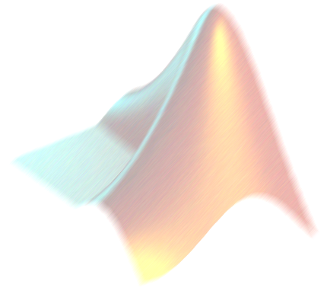
NUMERICAL INTEGRATION
AM2032 JAYANTA MUKHERJEE

Slide 2
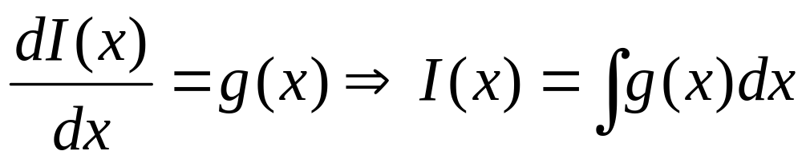
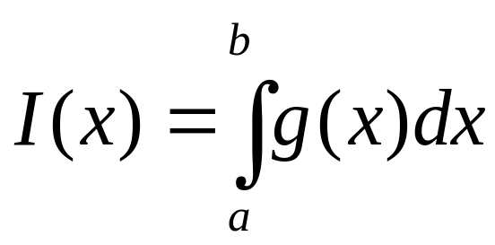
Integration
Mathematically: the inverse operation to differentiation.
Practically: the integral of a function g(x) (integrand) between the limits x₁ and x₂ is equivalent to the net area between the integrand and the x axis.
g(x)
a
b
x

Slide 3
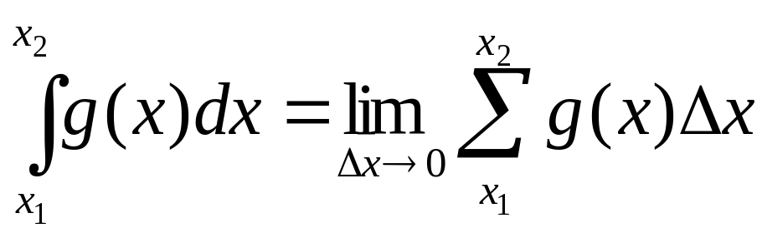
Numerical Integration
Often g(x) cannot be integrated analytically to give a closed form expression for I(x), e.g. solution to y΄=(1+xy). Motivates need to find approximate solutions for I(x).
In the differential limit, an integral is equivalent to a summation operation:
Approximate methods for determining integrals are mostly based on idea of area between integrand and axis.

Slide 4
What Will We Learn?
Basic Numerical Integration: Set of Rules
Trapezoidal Rule
Simpson’s Rule
  1/3 Rule
  3/8 Rule
Midpoint
Gaussian Quadrature
Closed form (end points are used)
Open form (end points are not used)

Slide 5
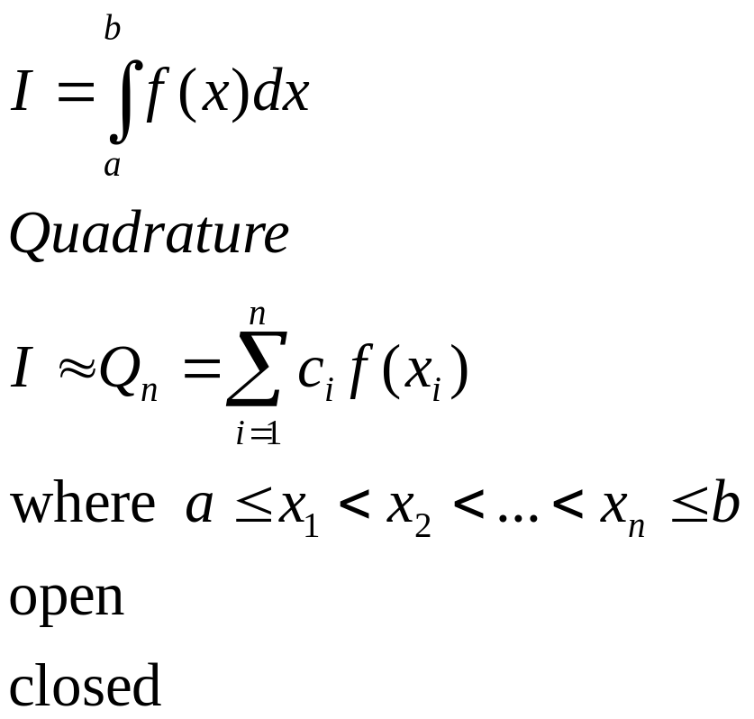
Basic Numerical Integration
We want to find integration of functions of various forms of the equation known as the Newton Cotes integration formulas.

Slide 6
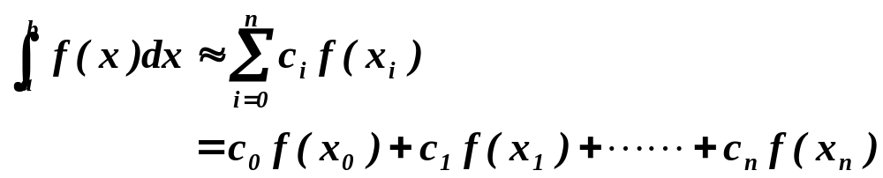
Basic Numerical Integration
Weighted sum of function values
f(x)
x₀
x₁
x_{n-1}
x_{n}
x

Slide 7
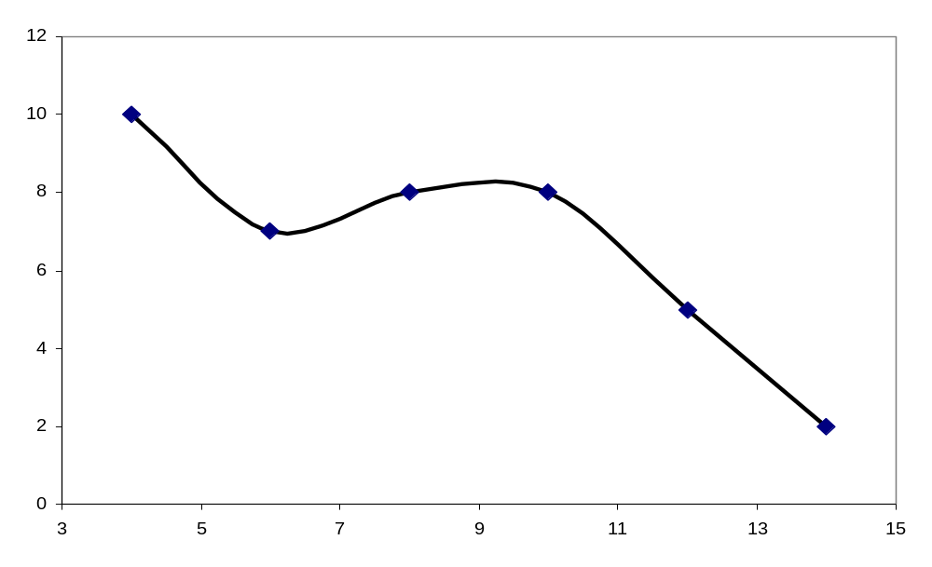
Numerical Integration
Idea is to do integral in small parts, like the way you first learned integration - a summation

Slide 8
Numerical Integration
Newton-Cotes Closed Formulae -- Use both end points
  Trapezoidal Rule : Linear
  Simpson’s 1/3-Rule : Quadratic
  Simpson’s 3/8-Rule : Cubic
  Boole’s Rule : Fourth-order

Slide 9
Numerical Integration
Newton-Cotes Open Formulae –
Use only interior points
  midpoint rule

Slide 10
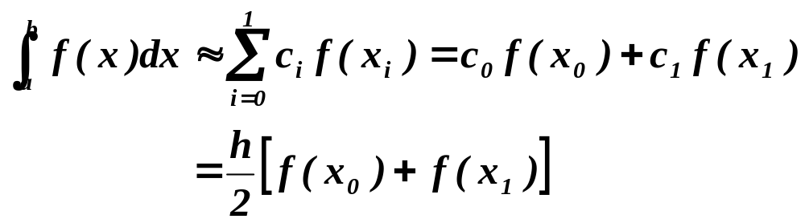
Trapezoid Rule
Straight-line approximation (n=1)
f(x)
L(x)
x₀
x₁
x

Slide 11
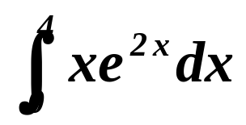
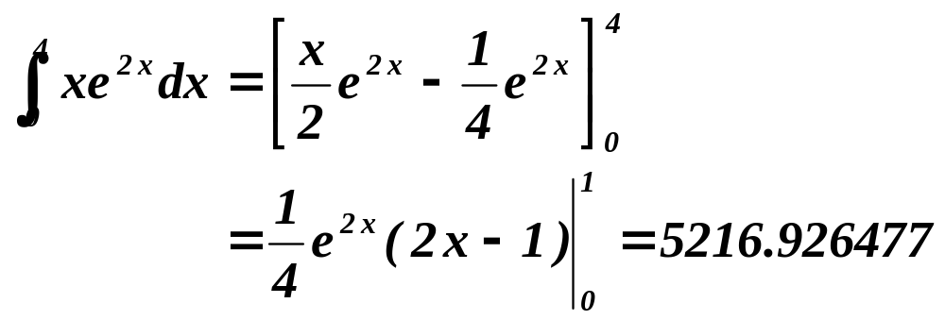
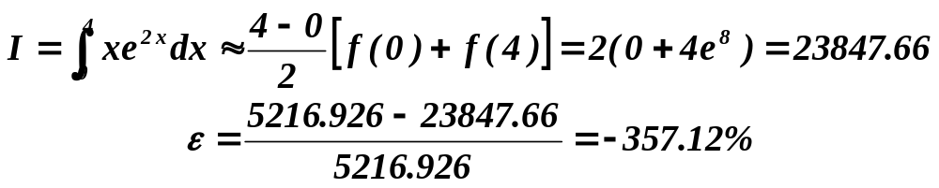
Example:Trapezoid Rule
Evaluate the integral
Exact solution
Trapezoidal Rule

Slide 12
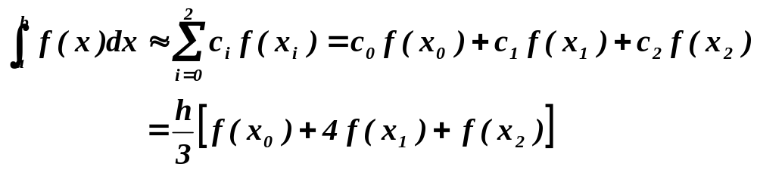
Simpson’s 1/3-Rule
Approximate the function by a parabola (n=2)
L(x)
f(x)
x₀
h
x₁
h
x₂
x

Slide 13
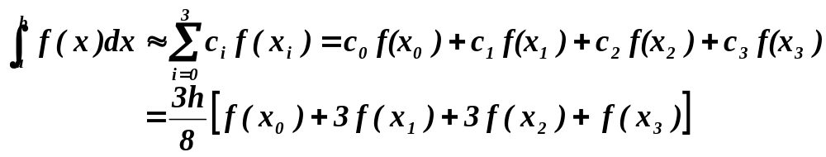
Simpson’s 3/8-Rule
Approximate by a cubic polynomial (n=3)
L(x)
f(x)
x₀
h
x₁
h
x₂
h
x₃
x

Slide 14
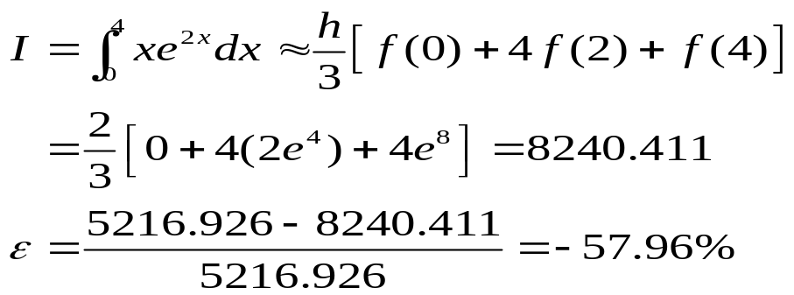
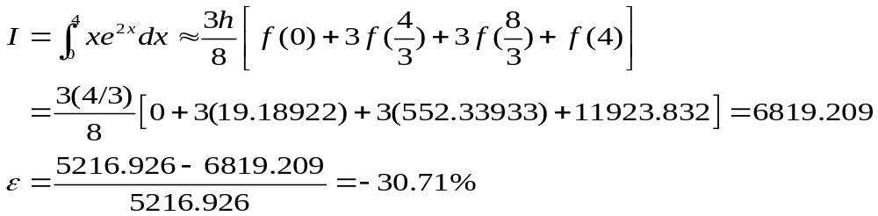
Example: Simpson’s Rules
Evaluate the Integral
Simpson’s 1/3-Rule
Simpson’s 3/8-Rule

Slide 15
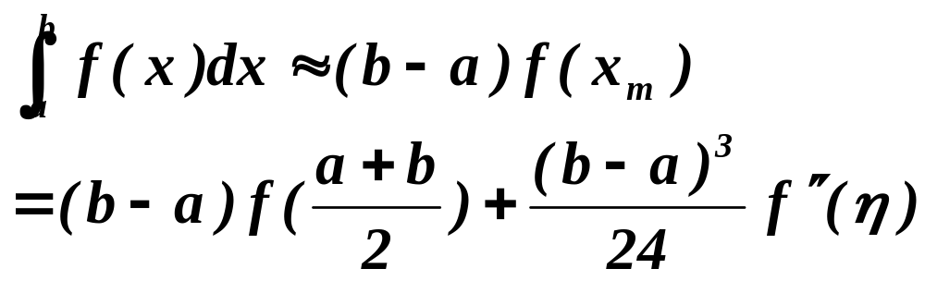
Midpoint Rule
Newton-Cotes Open Formula
f(x)
a
x_{m}
b
x

Slide 16
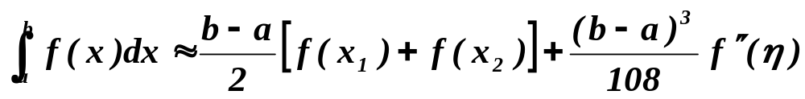
Two-point Newton-Cotes Open Formula
Approximate by a straight line
f(x)
x₀
h
x₁
h
x₂
h
x₃
x

Slide 17
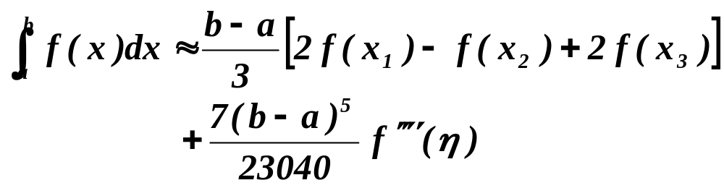
Three-Point Newton-Cotes Open Formula
Approximate by a parabola
f(x)
x₀
h
x₁
h
x₂
h
x₃
h
x₄
x

Slide 18
Better Numerical Integration
Composite integration
  Composite Trapezoidal Rule
  Composite Simpson’s Rule
Romberg integration

Slide 19
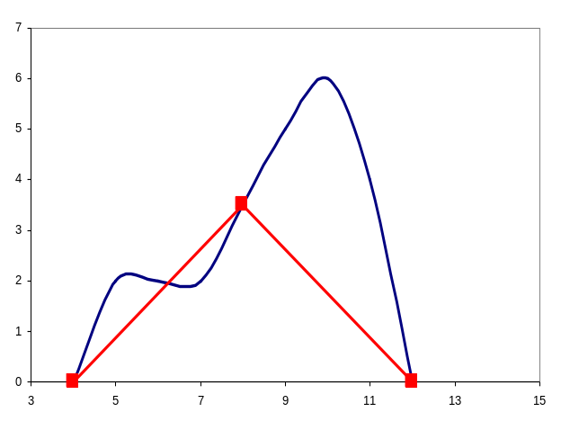
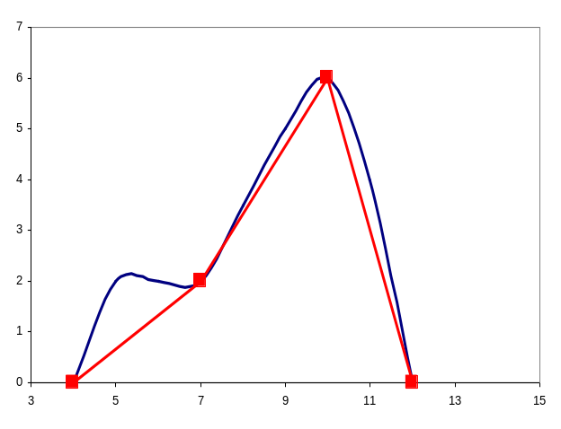
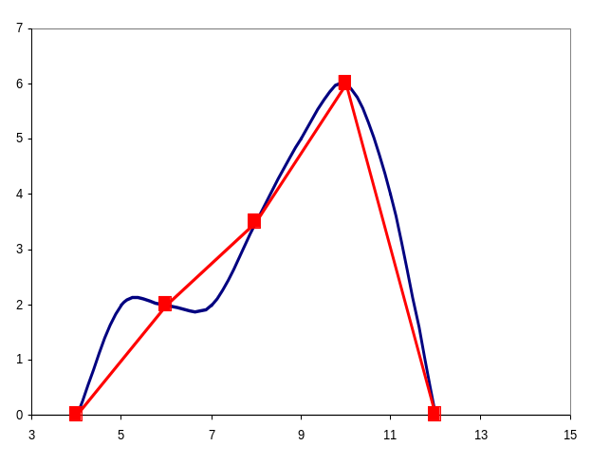
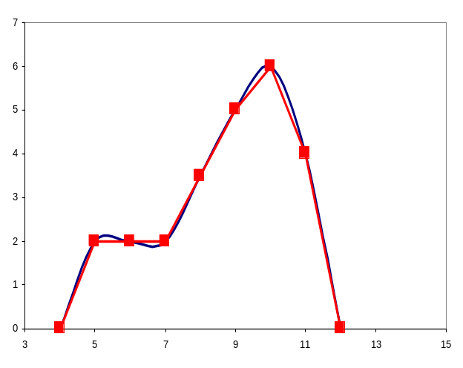
Apply Trapezoid Rule to Multiple Segments Over Integration Limits
Two segments
Three segments
Four segments
Many segments
AM2032 JAYANTA MUKHERJEE

Slide 20
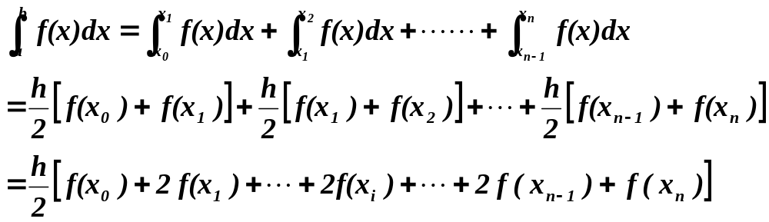
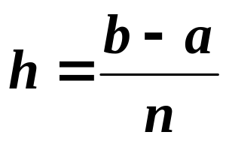
Composite Trapezoid Rule
f(x)
x₀
h
x₁
h
x₂
h
x₃
h
x₄
x

Slide 21
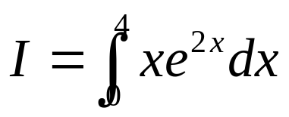
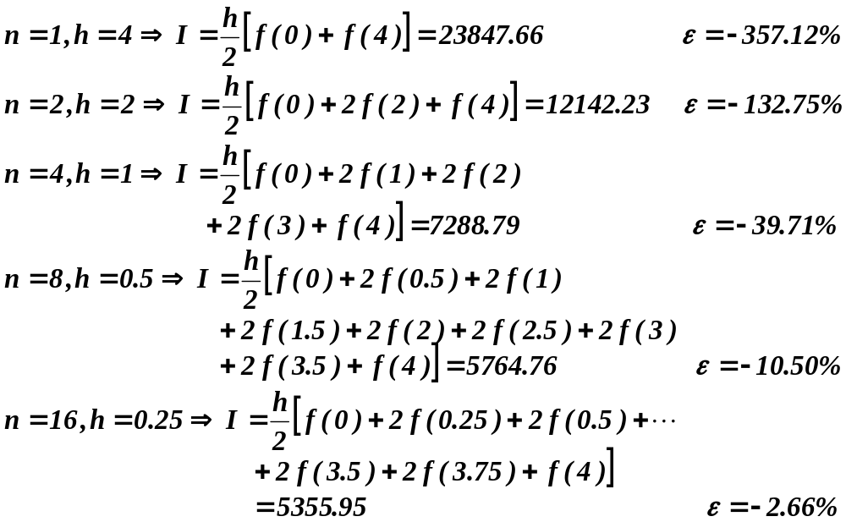
Composite Trapezoid Rule
Evaluate the integral

Slide 22
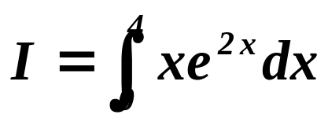
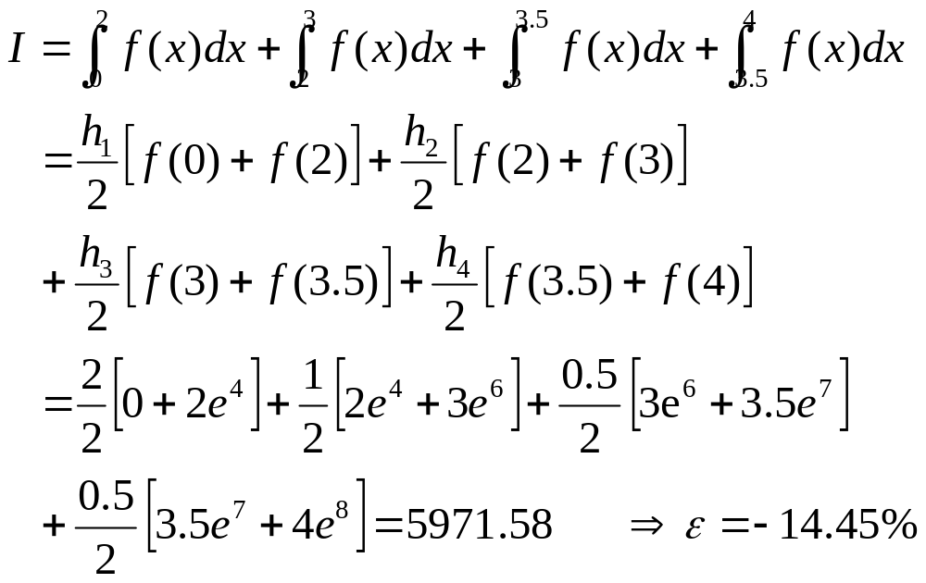
Composite Trapezoid Rule with Unequal Segments
Evaluate the integral
h₁ = 2, h₂ = 1, h₃ = 0.5, h₄ = 0.5

Slide 23
Composite Simpson’s Rule
Piecewise Quadratic approximations
f(x)
…...
x₀
h
x₁
x
h
x₂
h
x₃
h
x₄
x_{n-2}
x_{n-1}
x_{n}

Slide 24
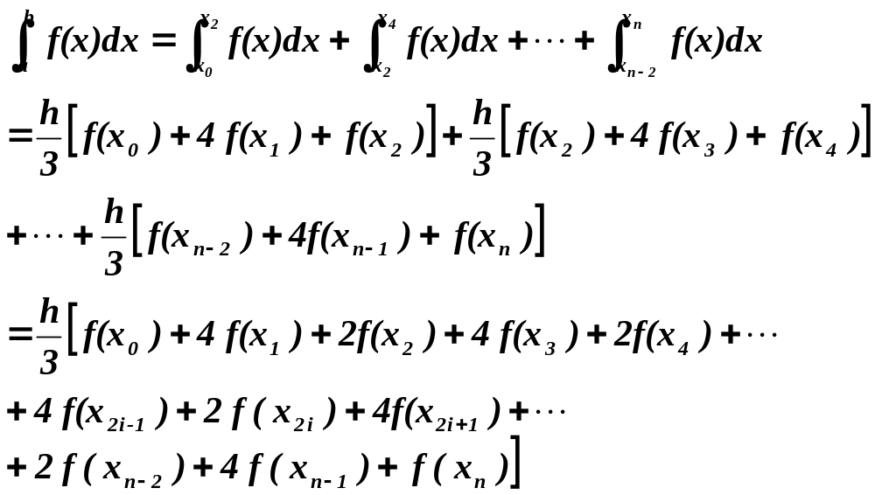
Composite Simpson’s Rule
Multiple applications of Simpson’s rule

Slide 25
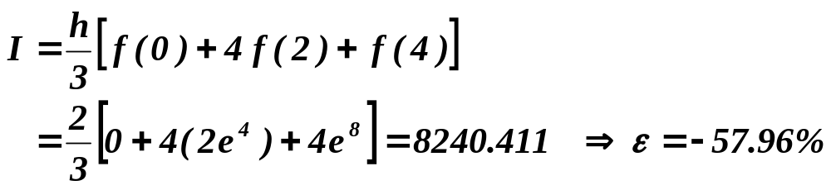
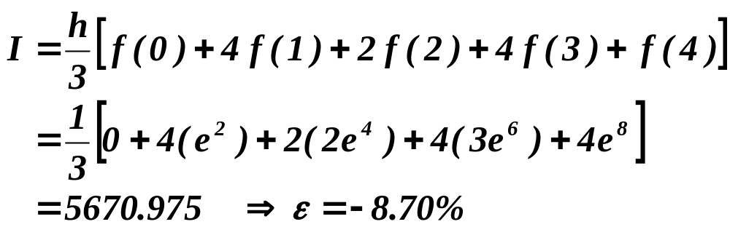
Composite Simpson’s Rule
Evaluate the integral
n = 2, h = 2
n = 4, h = 1

Slide 26
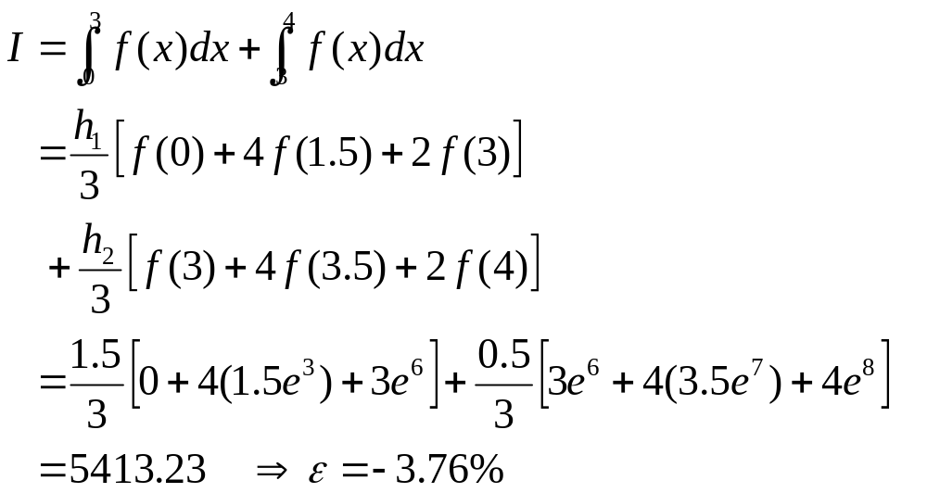
Composite Simpson’s Rule with Unequal Segments
Evaluate the integral
h₁ = 1.5, h₂ = 0.5

Slide 27
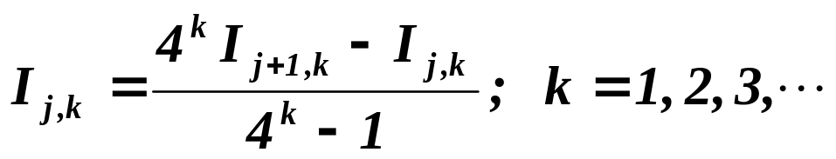
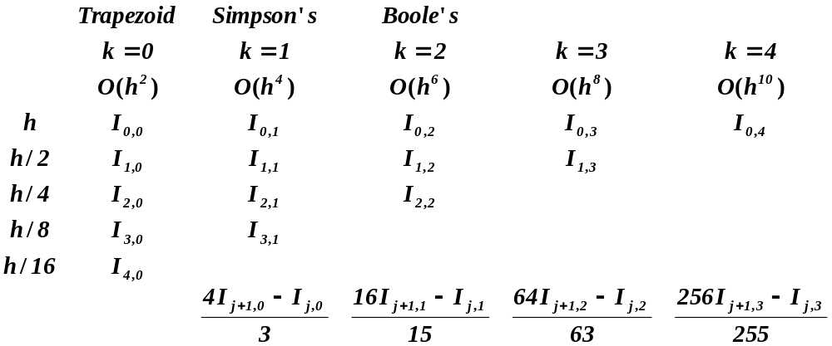
Romberg Integration

Slide 28
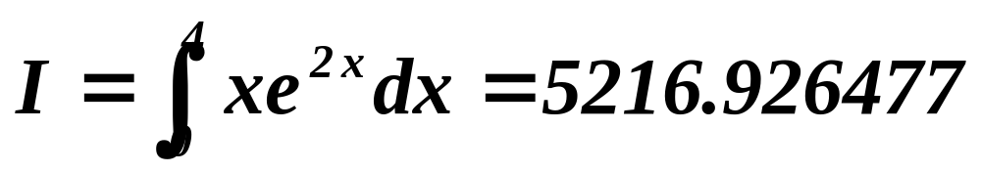
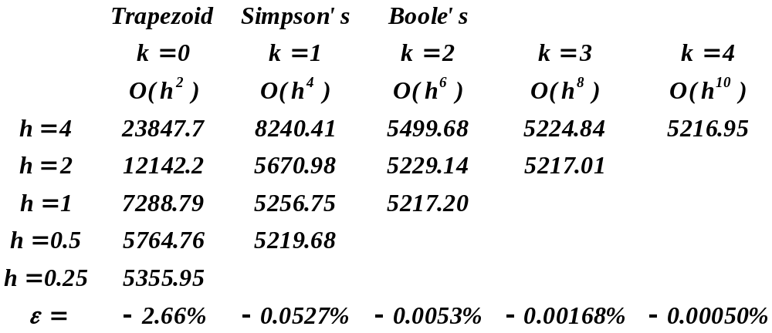
Romberg Integration

Slide 29
Gaussian Quadratures
Newton-Cotes Formulae
  use evenly-spaced functional values
Gaussian Quadratures
  select functional values at non-uniformly distributed points to achieve higher accuracy
  change of variables so that the interval of integration is [-1,1]

Slide 30
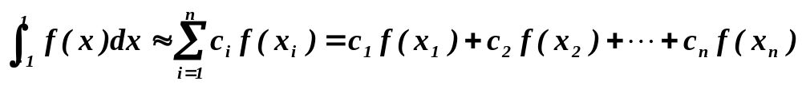
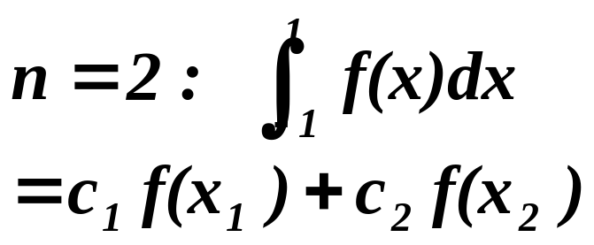
Gaussian Quadrature on [-1, 1]
-1
x₁
x₂
1
Choose (c₁, c₂, x₁, x₂) such that the method yields “exact integral” for f(x) = x⁰, x¹, x², x³

Slide 31
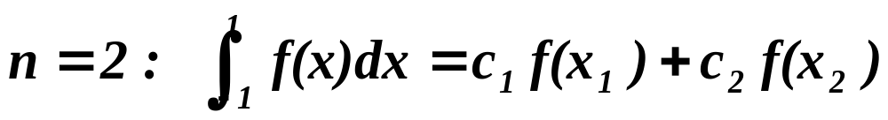
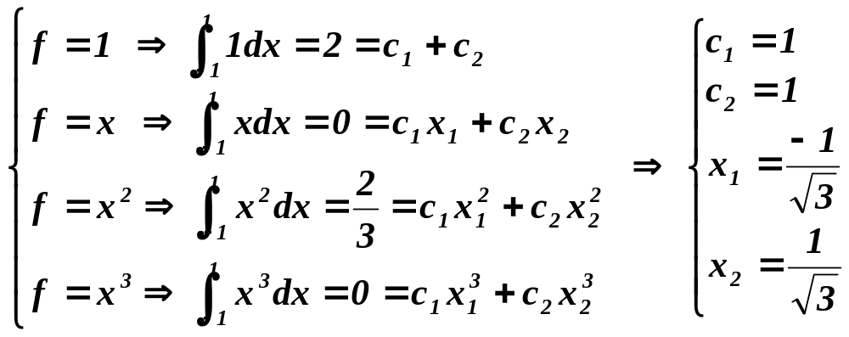
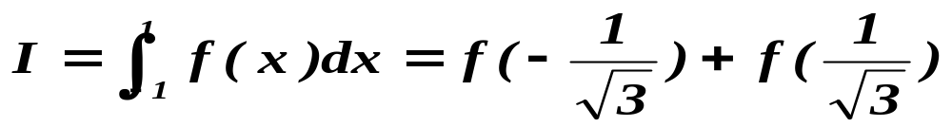
Gaussian Quadrature on [-1, 1]
Exact integral for f = x⁰, x¹, x², x³
  Four equations for four unknowns

Slide 32
Gaussian Quadrature on [-1, 1]
-1
x₁
x₂
x₃
1
Choose (c₁, c₂, c₃, x₁, x₂, x₃) such that the method yields “exact integral” for f(x) = x⁰, x¹, x², x³,x⁴, x⁵

Slide 33
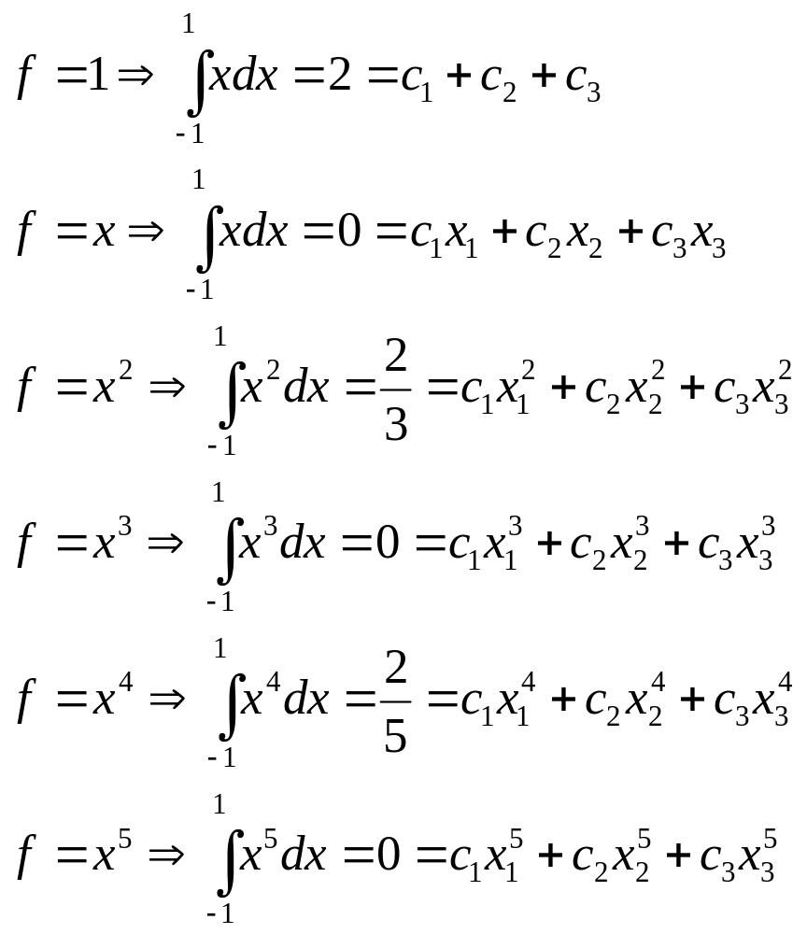
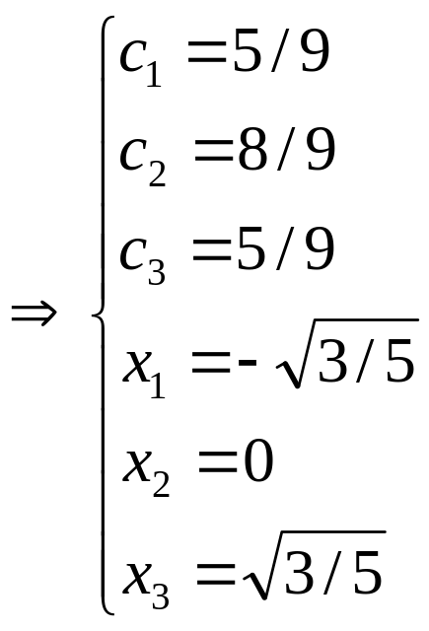
Gaussian Quadrature on [-1, 1]

Slide 34
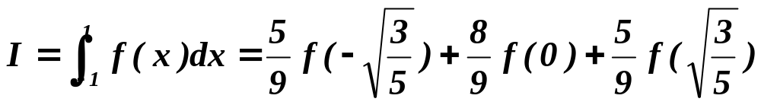
Gaussian Quadrature on [-1, 1]
Exact integral for f = x⁰, x¹, x², x^{3,} x⁴, x⁵

Slide 35
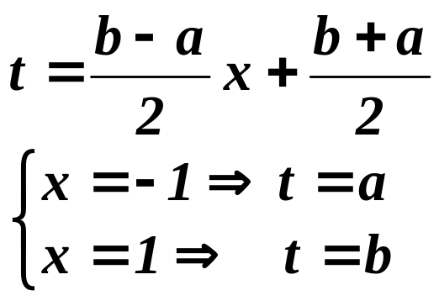
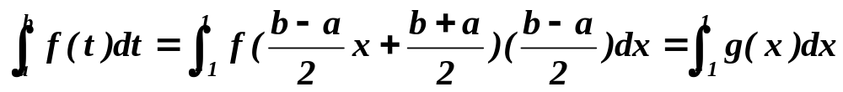
Gaussian Quadrature on [a, b]
Coordinate transformation from [a,b] to [-1,1]
a
t₁
t₂
b

Slide 36
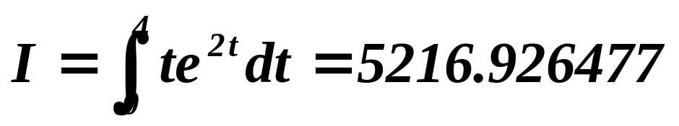
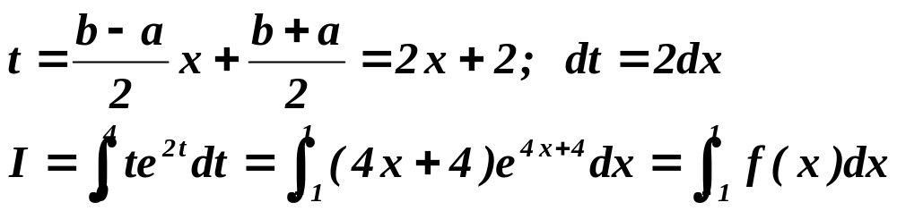
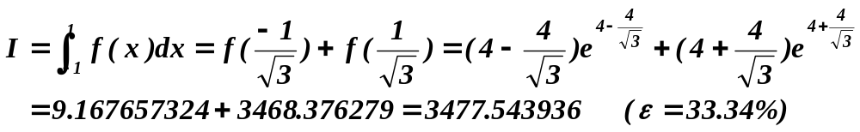
Example: Gaussian Quadrature
Evaluate
Coordinate transformation
Two-point formula

Slide 37
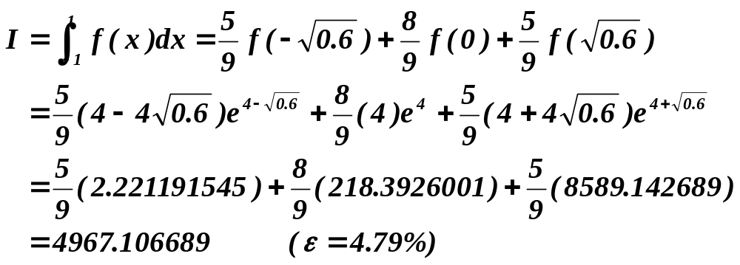

Example: Gaussian Quadrature
Three-point formula
Four-point formula

Slide 38
Comparison of the Integration Formulae
Simpson’s rule with ‘n’ points gives about as much accuracy as Trapezoidal rule with ‘2n’ points.
If Gauss quadrature is used we may attain the same accuracy with ‘n/2’ points: An advantage over Simpson’s rule.
But, there is no easy way of picking the intervals in Gauss method: So we end up using Trapezoidal/ Simpson’s rules
We may be given tabulated functions already tabulated at equal intervals in which case only trapezoidal and Simpson’s rules can be applied
If the given function is given at random unequal intervals only Trapezoidal rule can be applied

Slide 39
Next Lecture: Introduction to numerical solutions of differential equations

